Slide 1
Integer
LESSON 4

Slide 2
注意事项：
本讲对应教材第2章“信息的表示和处理”中的2.2和2.3节。其中2.2.1~2.2.4节和2.3节请大家自学完成。
本章中包含很多公式推导，大家不用过于关注，只需要掌握基本原理和结论即可。

Slide 3
Outline
Encoding
Unsigned and Two’s complement
Conversions
Operations

Slide 4
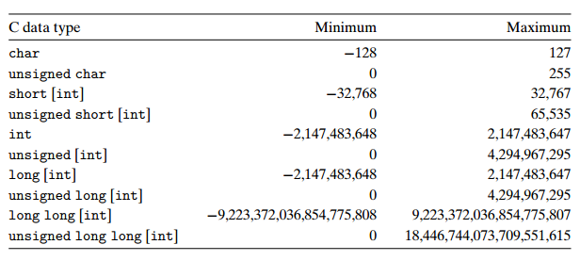
Integer Representations
Typical ranges for C integral data types on a 32-bit machine. Text in square brackets is optional.

Slide 5
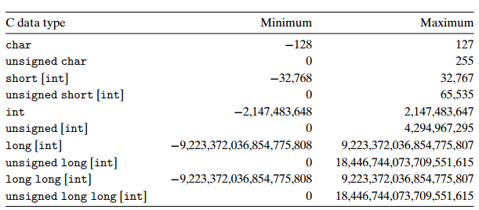
Integer Representations
Typical ranges for C integral data types on a 64-bit machine.

Slide 6
Binary, Unsigned & Signed
Binary
w Bit vector
Using Two’s complement to represent integer
Unsigned
Two’s Complement（补码）
Sign Bit

Slide 7
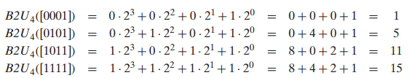
Unsigned Encodings
Notes:
Data type long long was introduced with ISO C99

Slide 8
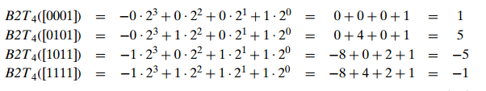
Two’s-Complement Encodings

Slide 9
Two’s-Complement Encodings
If nonnegative ( x_{w-1} = 0 )
Nothing changes
If negative ( x_{w-1} = 1 )
（等比数列求和公式）

Slide 10
Two’s Complement
Two’s Complement
-5 0101 (raw binary)
1010 (after complement)
1011 (2’s complement)

Slide 11
Two’s Complement Encoding Examples
Binary/Hexadecimal Representation for 12345
Binary: 0011 0000 0011 1001
Hex: 3 0 3 9
Binary/Hexadecimal Representation for –12345
Binary: 1100 1111 1100 0111
Hex: C F C 7

Slide 12
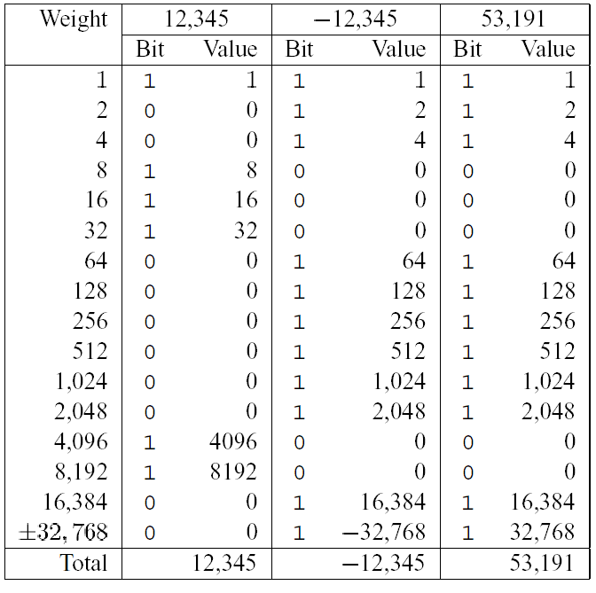

Slide 13
Numeric Range
Unsigned Values
Umin = 0
Umax = 2^{w}-1
Two’s Complement Values
Tmin = -2^{w-1}
Tmax = 2^{w-1}-1

Slide 14
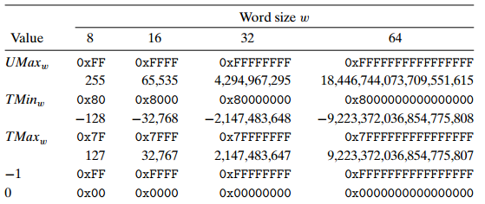
Important numbers
Both numeric values and hexadecimal representations are shown.

Slide 15
Numeric Range
Relationship
|TMin| = TMax + 1
Umax = 2 x TMax + 1
-1 has the same bit representation as Umax,
a string of all 1s
Numeric value 0 is represented as
a string of all 0s in both representations

Slide 16
Unsigned & Signed Numeric Values
Equivalence
Same encodings for nonnegative values
Uniqueness
Every bit pattern represents unique integer value
Each representable integer has unique bit encoding
⇒ Can Invert Mappings
U2B(x) = B2U⁻¹(x)
Bit pattern for unsigned integer
T2B(x) = B2T⁻¹(x)
Bit pattern for two’s comp integer
X
B2U(X)
B2T(X)
0000
0
0
0001
1
1
0010
2
2
0011
3
3
0100
4
4
0101
5
5
0110
6
6
0111
7
7
1000
8
–8
1001
9
–7
1010
10
–6
1011
11
–5
1100
12
–4
1101
13
–3
1110
14
–2
1111
15
–1
Notes:
相同点
非负数具有相同的编码方式
Uniqueness 唯一性
每个位模式都表示唯一的整数值
每个可表示的整数都有唯一的位编码

Slide 17
Alternative Representations
One’s Complement （反码） :
The most significant bit has weight -(2^{w-1}-1)
Sign-Magnitude （原码） :
The most significant bit is a sign bit
that determines whether the remaining bits should be given negative or positive weight

Slide 18
Outline
Encoding
Conversions
Signed v.s. unsigned
Extension and Truncation
Operations

Slide 19
Signed vs. Unsigned in C
Constants
By default are considered to be signed integers
Unsigned if have “U” as suffix
0U, 4294967259U
Notes:
suffix：后缀

Slide 20
Signed vs. Unsigned in C
Casting
Explicit casting between signed & unsigned same as U2T and T2U
int tx, ty;
unsigned ux, uy;
tx = (int) ux;
uy = (unsigned) ty;
Notes:
显式转换

Slide 21
Signed vs. Unsigned in C
Casting
Implicit casting also occurs via assignments and procedure calls
int tx, ty;
unsigned ux, uy;
tx = ux; /* Cast to signed */
uy = ty; /* Cast to unsigned */
基本原则：在C语言中，有符号数和无符号数可以相互转换。虽然，C标准没有规定如何进行这种转换，但大多数系统遵循的基本原则是在硬件底层的位表示保持不变，但数值可能改变。
Notes:
隐式转换

Slide 22
Casting Signed to Unsigned
C Allows Conversions from Signed to Unsigned
Resulting Value
No change in bit representation
Nonnegative values unchanged
ux = 12345
Negative values change into (large) positive values
uy = 53191
short int x = 12345; // 3039H
unsigned short int ux = (unsigned short) x;
short int y = -12345; // 0xCFC7
unsigned short int uy = (unsigned short) y;

Slide 23
Casting Convention
Expression Evaluation
If mix unsigned and signed in single expression
signed values implicitly cast to unsigned
Including comparison operations <, >, ==, <=, >=

Slide 24
Casting Convention
Examples for word size = 32
Constant1 | Relation | Constant2 | Evaluation
0 | == | 0U | unsigned
-1 | < | 0 | signed
-1 | > | 0U | unsigned
2147483647 | > | -2147483648 | signed
2147483647U | < | -2147483648 | unsigned
-1 | > | -2 | signed
(unsigned)-1 | > | -2 | unsigned

Slide 25
Practice Problem #1
Nonintuitive Features
/* WARNING: This is buggy code */
float sum_elements(float a[], unsigned length) {
int i;
float result = 0;
for (i = 0; i <= length-1; i++)
result += a[i];
return result;
}
Notes:
反直觉

Slide 26
Practice Problem #2
/* stdio.h */
typedef unsigned int size_t;
/* Prototype library function strlen */
size_t strlen(const char *s);
/* Determine whether string s is longer than stirng t */
/* WARNING: This function is buggy */
int strlonger(char *s, char *t) {
return strlen(s) – strlen(t) > 0;
}
Notes:
When you test this on some sample data, things do not seem to work quite right. You investigate further and determine that data type size_t is defined (via typedef) in header file stdio.h to be unsigned int.
strlen(s) > strlen(t)

Slide 27
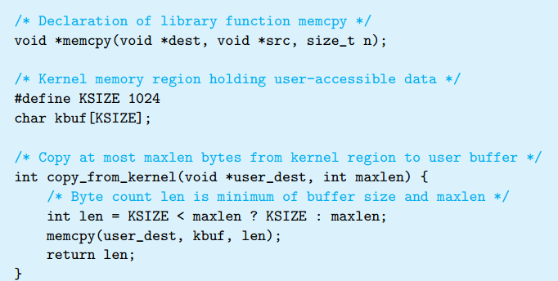
Practice Problem #3 Security vulnerability（脆弱性）
Notes:
In 2002, programmers involved in the FreeBSD open source operating systems project realized that their implementation of the getpeername library function had a security vulnerability. A simplified version of their code went something like this:
Suppose,however,thatsomemaliciousprogrammerwritescodethatcalls copy_from_kernelwith a negative value of maxlen. Then the minimum computation on line 16 will compute this value for len, which will then be passed as the parameter n to memcpy. Note, however, that parameter n is declared as having data type size_t. This data type is declared (via typedef) in the library file stdio.h. Typically it is defined to be unsigned int on 32-bit machines. Since argument n is unsigned, memcpy will treat it as a very large, positive number and attempt to copy that many bytes from the kernel region to the user’s buffer. Copying that many bytes (at least 231) will not actually work, because the program will encounter invalid addresses in the process, but the program could read regions of the kernel memory for which it is not authorized.

Slide 28
Outline
Encoding
Conversions
Signed v.s. unsigned
Extension and Truncation
Operations

Slide 29
Expanding the Bit Representation
Unsigned: Zero extension
Add leading 0s to the representation
Signed: Sign extension
[x_{w-1},x_{w-2},x_{w-3},…x₀]
X
• • •
• • •
X ′
• • •
• • •
基本原则：位扩展后的值保持不变。

Slide 30
Sign Extension Example
short int x = 12345;
int ix = (int) x;
short int y = -12345;
int iy = (int) y;
Decimal
Hex
Binary
x
12345
30 39
00110000 00111001
ix
12345
00 00 30 39
00000000 00000000 00110000 00111001
y
-12345
CF C7
11001111 11000111
iy
-12345
FF FF CF C7
11111111 11111111 11001111 11000111

Slide 31
Truncating Numbers
int x = 53191;
short sx = (short) x;
int y = sx;
Decimal
Hex
Binary
x
53191
00 00 CF C7
00000000 00000000 11001111 11000111
sx
-12345
CF C7
11001111 11000111
y
-12345
FF FF CF C7
11111111 11111111 11001111 11000111
X ′
• • •
• • •
基本原则：位截断后可能改变其值（溢出）。
X
• • •

Slide 32
Why Should I Use Unsigned?
Don’t Use Just Because Number Nonnegative
Easy to make mistakes
Can be very subtle(不易察觉的)
Do Use When
Bit Vectors
Mask
Address
Multiprecision Arithmetic
unsigned i;
for (i = cnt-2; i >= 0; i --)
a[i] += a[i-1]
#define DELTA sizeof(int)
int i;
for (i = cnt; i-DELTA >= 0; i -= DELTA)
...

Slide 33
Summary
程序中有符号整型数据和无符号整型数据相互转化时，底层硬件上的位表示是相同的，只是软件（编译器）对其解释不同。
位扩展分为零扩展和符号扩展。扩展后的值保持不变。
位截断可能会造成值变化（溢出）。
表达式中同时出现无符号数和有符号数，则统一按无符号数处理，需特别小心。

Slide 34
Outline
Encoding
Conversions
Operations
Addition
Negation (signed)
Multiplication
Using Shift to perform power-of-2 multiply/divide

Slide 35
Mathematical Integer Addition
Integer Addition
4-bit integers u,v
Compute true sum Add₄(u, v)
Values increase linearly with u and v
Form planar surface（平面）

Slide 36
Unsigned Addition
u
• • •
Operands: w bits
+
v
• • •
True Sum: w+1 bits
u + v
• • •
Discard Carry: w bits
UAdd_{w}(u , v)
• • •

Slide 37
Unsigned Addition
Standard Addition Function
Ignores carry output
Implements Modular Arithmetic
s = UAdd_{w}(u , v) = ADD_{w}(u, v) mod 2^{w}

Slide 38
Visualizing Unsigned Addition
Overflow
Wraps Around
If true sum ≥ 2^{w}
At most once
UAdd₄(u , v)
True Sum
2^{w+1}
Overflow
2^{w}
v
0
Modular Sum
u
Notes:
At most once 最多一次
Module: 取模

Slide 39
Abelian Group
Closed under addition
0 ≤ UAdd_{w}(u , v) ≤ 2^{w} –1
Commutative （交换律）
UAdd_{w}(u , v) = UAdd_{w}(v , u)
Associative （结合律）
UAdd_{w} (t, UAdd_{w} (u,v)) = UAdd_{w} (UAdd_{w} (t, u ), v)
0 is additive identity
UAdd_{w} (u , 0) = u
Every element has additive inverse
Let UComp_{w} (u ) = 2^{w} – u
UAdd_{w}(u , UComp_{w} (u )) = 0
Notes:
有限阿贝尔群

Slide 40
Signed Addition
Functionality
True sum requires w+1 bits
Drop off MSB
Treat remaining bits as 2’s comp. integer
PosOver： Positive Overflow
NegOver：Negative Overflow

Slide 41
Signed Addition
True Sum
PosOver
TAdd(u , v)
0 111…1
2^{w}–1
PosOver
TAdd Result
> 0
0 100…0
2^{w –1}
011…1
v
< 0
0 000…0
0
000…0
< 0
> 0
u
NegOver
1 100…0
–2^{w –1}
100…0
1 000…0
–2^{w}
NegOver

Slide 42
Visualizing 2’s Comp. Addition
Values
4-bit two’s comp.
Range from -8 to +7
Wraps Around
If sum ≥ 2^{w-1}
Becomes negative
If sum < –2^{w–1}
Becomes positive
NegOver
TAdd₄(u , v)
v
u
PosOver

Slide 43
Detecting TAdd Overflow
Task
Given s = TAdd_{w}(u , v)
Determine if s == Add_{w}(u , v)
Claim
Overflow iff （当且仅当） either:
u, v < 0, s ≥ 0 (NegOver)
u, v ≥ 0, s < 0 (PosOver)
overflow = (u<0 == v<0) && (u<0 != s<0)
2^{w}–1
PosOver
2^{w –1}
0
NegOver
Notes:
Given：假设
Determine：
Iff ： if and only if

Slide 44
Outline
Encoding
Conversions
Operations
Addition
Negation (signed)
Multiplication
Using Shift to perform power-of-2 multiply/divide

Slide 45
Negating with Complement & Increment
In C Language
~x + 1 == -x
Complement
Observation: ~x + x == 1111…111 == -1
~x：Complement（反码）
x
1
0
0
1
1
1
0
1
+
~x
0
1
1
0
0
0
1
0
-1
1
1
1
1
1
1
1
1
Notes:
取反加1
Complement互补

Slide 46
Negation

Slide 47
Outline
Encoding
Conversions
Operations
Addition
Negation (signed)
Multiplication
Using Shift to perform power-of-2 multiply/divide

Slide 48
Multiplication
Computing Exact Product（积） of w-bit numbers x, y
Either signed or unsigned
Ranges
Unsigned: 0 ≤ x * y ≤ (2^{w} – 1) ² = 2^{2w} – 2^{w+1} + 1
Up to 2w bits
Two’s complement min: x *y ≥–2^{w–1}*(2^{w–1}–1) = –2^{2w–2} + 2^{w–1}
Up to 2w–1 bits (including sign bit)
Two’s complement max: x * y ≤ (–2^{w–1}) ² = 2^{2w–2}
Up to 2w bits (including sign bit), but only for TMinw²
-128 * -128 = 16384 = 4000H = 100 0000 0000 0000B
The 2’s complement is 0100 0000 0000 0000
sign bit

Slide 49
Multiplication
Maintaining Exact Results
Would need to keep expanding word size with each product computed
Done in software by “arbitrary precision” arithmetic packages
Notes:
arithmetic packages：算术包

Slide 50
Unsigned Multiplication
u
• • •
Operands: w bits
*
v
• • •
True Product: 2w bits
u · v
• • •
• • •
Discard w bits: w bits
UMult_{w}(u , v)
• • •
Standard Multiplication Function
Ignores high order w bits
Implements Modular Arithmetic
UMult_{w}(u, v) = (u · v) mod 2^{w}

Slide 51
Signed Multiplication
u
• • •
Operands: w bits
*
v
• • •
True Product: 2w bits
u · v
• • •
• • •
Discard w bits: w bits
TMult_{w}(u , v)
• • •
Standard Multiplication Function
Ignores high order w bits
Some of which are different for signed vs. unsigned multiplication
Lower bits are the same
TMult_{w}(u, v) = U2T_{w}( (u · v) mod 2^{w} )
The same instruction is used for signed & unsigned multiplication

Slide 52
Outline
Encoding
Conversions
Operations
Addition
Negation (signed)
Multiplication
Using Shift to perform power-of-2 multiply/divide

Slide 53
Power-of-2 Multiply with Shift
Operation
u << k gives u * 2^{k}
Both signed and unsigned
Examples
(u << 3) == (u * 8)
(u << 5) - (u << 3) == u * 24
Most machines shift and add much faster than multiply
Compiler will generate this code automatically
k
u
• • •
Operands: w bits
*
2^{k}
0
•••
0
1
0
•••
0
0
True Product: w+k bits
u · 2^{k}
• • •
0
•••
0
0
UMult_{w}(u , 2^{k})
•••
0
•••
0
0
Discard k bits: w bits
TMult_{w}(u , 2^{k})
Notes:
乘以2的幂，移位运算

Slide 54
Unsigned Power-of-2 Divide with Shift
Quotient（商） of Unsigned by Power of 2
u >> k gives ⎣ u / 2^{k} ⎦
Uses logical shift
k
u
•••
•••
Binary Point
Operands:
/
2^{k}
0
•••
0
1
0
•••
0
0
Division:
u / 2^{k}
0
•••
0
0
•••
.
•••
Quotient:
⎣u / 2^{k}⎦
0
•••
0
0
•••
Notes:
Quotient：商

Slide 55
Signed Power-of-2 Divide with Shift
Quotient of Signed by Power of 2
u >> k gives ⎣ u / 2^{k} ⎦
Uses arithmetic shift
Rounds wrong direction when u < 0
k
u
•••
•••
Binary Point
Operands:
/
2^{k}
0
•••
0
1
0
•••
0
0
Division:
u / 2^{k}
0
•••
•••
.
•••
Result:
RoundDown(u / 2^{k})
0
•••
•••
Notes:
算术右移运算实际上是做了除法运算并向下取整
在u大于等于0时，等价于除以2的k次方
在u小于0时，并不等价，取整的方向有问题

Slide 56
Correct Power-of-2 Divide
Quotient of Negative Number by Power of 2
Want ⎡ u / 2^{k} ⎤ (Round Toward 0)
Compute as ⎣ (u+2^{k}-1)/ 2^{k} ⎦
In C: (u + (1<<k)-1) >> k
Biases divided toward 0
Case 1: No rounding
k
Dividend:
u
1
•••
0
•••
0
0
+2^{k} +–1
0
•••
0
0
1
•••
1
1
1
•••
1
•••
1
1
Binary Point
Divisor:
/
2^{k}
0
•••
0
1
0
•••
0
0
⎡ u / 2^{k} ⎤
0
.
1
•••
1
1
1
•••
1
•••
1
1
Biasing has no effect
Notes:
除法的取整本质上是向0取整
所以需要当u小于0时，进行修正，以实现向0取整

Slide 57
Correct Power-of-2 Divide
Case 2: Rounding
k
Dividend:
u
1
•••
•••
+2^{k} +–1
0
•••
0
0
1
•••
1
1
1
•••
•••
Incremented by 1
Binary Point
Divisor:
/
2^{k}
0
•••
0
1
0
•••
0
0
⎡ u / 2^{k} ⎤
.
0
1
•••
1
1
1
•••
•••
Incremented by 1
Biasing adds 1 to final result

Slide 58
Summary
Addition
Unsigned/signed: Normal addition followed by truncate,
same operation on bit level
Unsigned: addition mod 2^{w}
Mathematical addition + possible subtraction of 2^{w}
Signed: modified addition mod 2^{w} (result in proper range)
Mathematical addition + possible addition or subtraction of 2^{w}
Multiplication
Unsigned/signed: Normal multiplication followed by truncate,
same operation on bit level
Unsigned: multiplication mod 2^{w}
Signed: modified multiplication mod 2^{w} (result in proper range)

